Slide 1

Английский язык
Тема 1:
Грамматика и
лексика

Slide 2
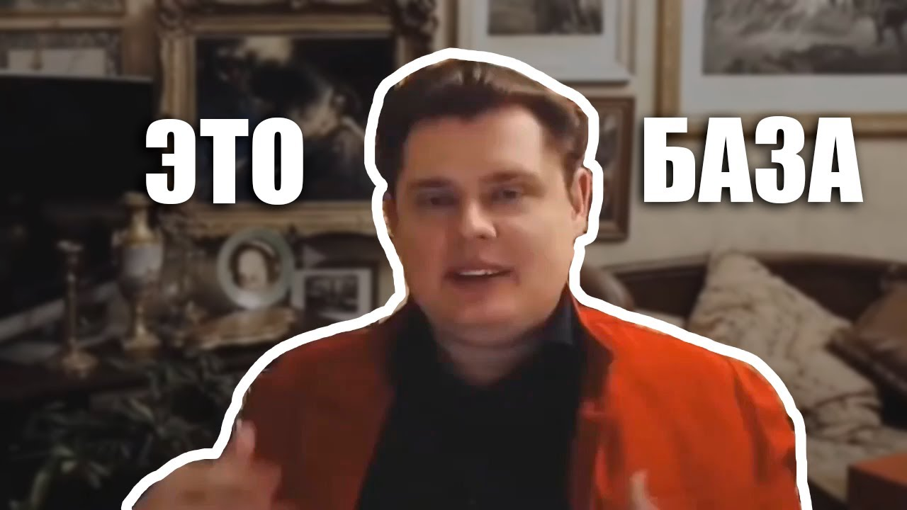

Nouns (существительные)
S, CH, SH, X or Z + ES
Ед. ч. | Мн. ч.
Box Bus Quiz | Boxes Buses Quizzes
Но если CH читается, как К, просто добавляем S: stomach – stomachs
O + S
Ед. ч. | Мн. ч.
Piano Photo Radio Kilo Zero Video Zoo Kangaroo | Pianos Photos Radios Kilos Zeros Videos Zoos Kangaroos
Ед. ч. | Мн. ч.
Man Policeman Woman Child Tooth Person Goose Mouse Foot Ox Fish Sheep Deer Aircraft | Men Policemen Women Children Teeth People Geese Mice Feet Oxen Fish Sheep Deer Aircraft
ГЛАСНАЯ + Y = S
Ед. ч. | Мн. ч.
Toy Key | Toys Keys
СОГЛАСНАЯ + y = IES
Ед. ч. | Мн. ч.
Family Story | Families Stories

Slide 3
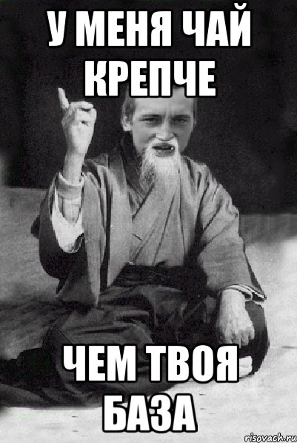

Nouns (существительные)
Ед. ч. | Мн. ч.
Crisis Oasis Datum Cactus Bacterium Phenomenon Stimulus Mother-in-law | Crises Oases Data Cacti Bacteria Phenomena Stimuli Mothers-in-law
O + ES
Ед. ч. | Мн. ч.
Hero Potato Volcano Tomato | Heroes Potatoes Volcanoes Tomatoes
F / FE = VES
Ед. ч. | Мн. ч.
Leaf Wife Искл: Roof Cliff | Leaves Wives Roofs Cliffs

Slide 4

ADJECTIVES
Adjective | Comparative | Superlative
Short Adj. (1 слог) и все прил., заканч. на Y Big Short Fine Friendly | Bigger Shorter Finer Friendlier | Biggest Shortest Finest Friendliest
Long Adj. (больше 1 слога) Beautiful | More beautiful | Most beautiful
Irregular Good Bad Far Little (мало) Much/many | Better Worse Further Less More | Best Worst Furthest Least Most

Slide 5
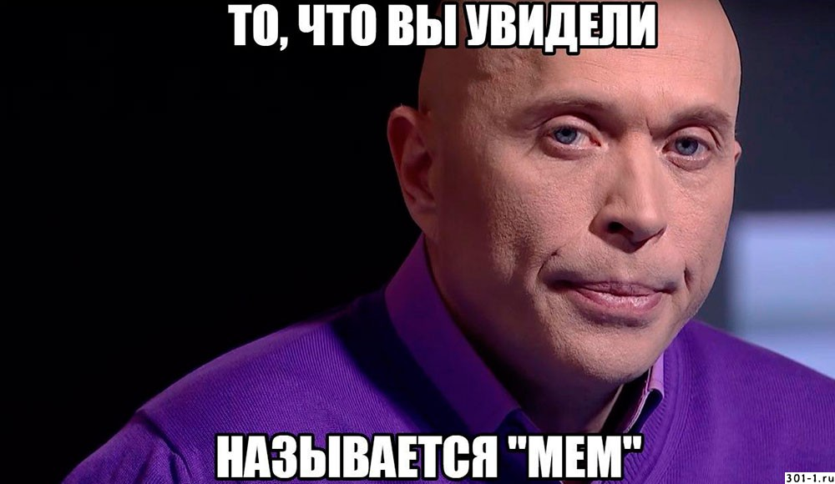
PRONOUNS
Именит. падеж | Др. падежи | Чей + сущ. | Чей (без сущ.) | Сам / себя
I | me | my | mine | myself
He | him | his | his | himself
She | her | her | hers | herself
It | it | its | its | itself
you | you | your | yours | yourself/yourselves
we | us | our | ours | ourselves
they | them | their | theirs | themselves

Slide 6
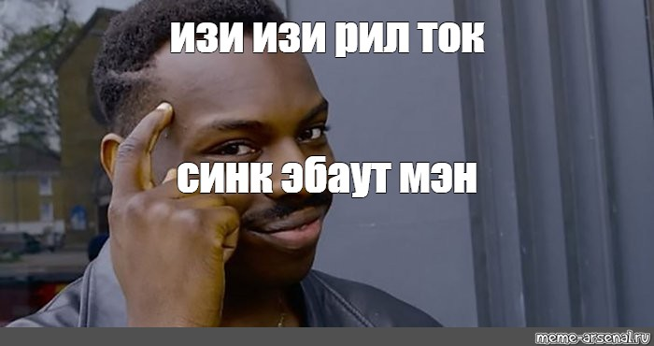
NUMBERS
Number | Порядковое
One Two Three Four Five Six Seven Eight Nine Ten Eleven Twelve Thirteen Twenty Thirty Twenty-one One hundred Four hundred and twenty-one One Two | First Second Third Fourth Fifth Sixth Seventh Eighth Ninth Tenth Eleventh Twelfth Thirteenth Twentieth Thirtieth Twenty-first One hundredth Four hundred and twenty-first Once (a week) Twice

Slide 7
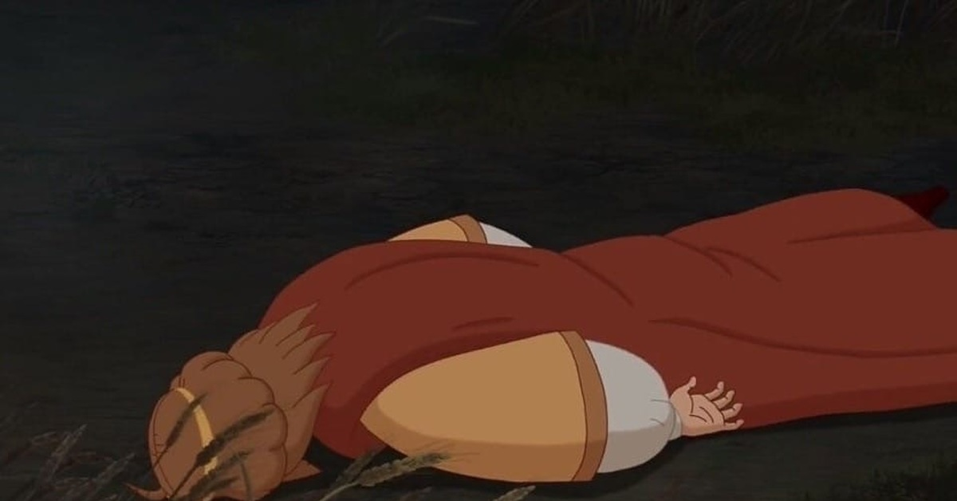

VERBS
1. IF Условные предложения
0 Conditional : If + Pr.S., Pr.S. (If you freeze water, it turns into ice)
1 Conditional: If + Pr.S., will/ won’t + V1 (If you don’t study, you won’t pass your exams)
2 Conditional: If + Past S., would/ wouldn’t + V1 (If I had 4 children, I wouldn’t work)
3 Conditional: If + Past Perfect, would/ wouldn’t have +V3/Ved (If people hadn’t voted for him, he wouldn’t have become President)
2. I wish + Past Simple (if we talk about the present) I wish I didn’t have to wear glasses.
+ Past Perf. (to talk about the past) I wish I had studied Chinese when I was at school.

Slide 8

VERBS
3. СКАЗУЕМОЕ ИЛИ НЕТ
Да, сказуемое:
Нет, не сказуемое:
1. Активное причастие (что делающий) – Ving (She heard a strange noise COMING from the
living room)
Пассивное причастие (что сделанный) – V3/Ved (He forgot about the money GIVEN to him by
Mr. Brown)
2. GERUND (Ving)
- После глаголов enjoy, hate, like, love, mind, spend, stop, finish, avoid, feel like, practise)
Have you finished TIDYING your room?
- После предлогов (I’m good at SOLVING problems) 3. Infinitive with TO (TO V)
- После глаголов decide, forget, hope, learn, need , offer, plan, promise, remember, want,
would like.
We’ve decided TO GO to France for our holiday.
- После прилагательных
It’s important TO REVISE for your exams.
ACTIVE | PASSIVE
Present Simple Present Continuous Present Perfect Present Perf. Cont. Past Simple Past Continuous Past Perfect Past Perf. Cont. Future Simple Future-in-the -past | Pr.Simple Passive (am/is/are + V3/Ved) Past Simple Passive (was/were + V3/Ved) Present Perfect Passive (Have/has been + V3/Ved) Future Simple Passive (will be + V3/Ved)

Slide 9

Спасибо за внимание!
.

